Slide 1
Mini Project
Topic : Expense Manager
Team Members : Rakshit Shah
Tejas Sheth
Het Patel
Vikas Kumar Sethiya

Slide 2
Problem Statement
To create a Java based Program for managing day to day expenses allowing user to keep a track of his/her Debited and Credited Amount on a daily basis, monthly basis and even yearly basis. To Notify user if he/she crosses a threshold amount and thus helping them in maintaining their balance and Expenses in a particular boundary.

Slide 3
Abstract :
According to a 2019 paper by Sumit Agarwal, Pulak Ghosh, Jing Li and Tianyue Ruan available on Asian Bureau of Finance and Economic Research, the advent of digital payments have led to overspending, especially among Indians. While curtailing digital transactions isn't the answer, monitoring one's spending could definitely help.
With this aim in mind, we have planned a Java-encoded application to keep track of the user's daily, monthly as well as yearly debited and credited amount. The program would also feature a threshold that the user can set and adjust, spending above which would be notified to the user. On the backend, JDK 8 would be used for Java implementation, with MySQL service for database and JDBC to connect the database. The user interface is to be designed using Java Swing.
In conclusion, we intend for our program to be a financial management assistant, especially for the young and the millennial cluster. We believe that the app has the potential to be a success in the market, especially among the young and millennial dynamic.

Slide 4
Introduction :
The main purpose of the Program is to develop and maintain an expense manager
Program enables users to keep track of their expenses.
Expense Management automation is the means by which - an organization or person can significantly track their expenses
Improve management control with calculating and processing corporate or personal expenses - Automated solution typically provides the ability to.

Slide 5
Introduction :
Improving Finance
Management Control
Expense
Management
Import & Export
Amount activities
Reducing
Paper work
Generate expenditure
By different categories

Slide 6
FrontEnd

Slide 7
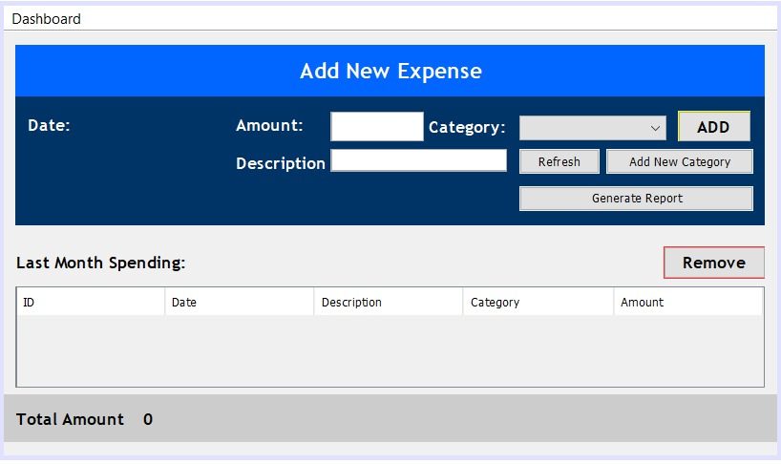

Slide 8
BackEnd

Slide 9
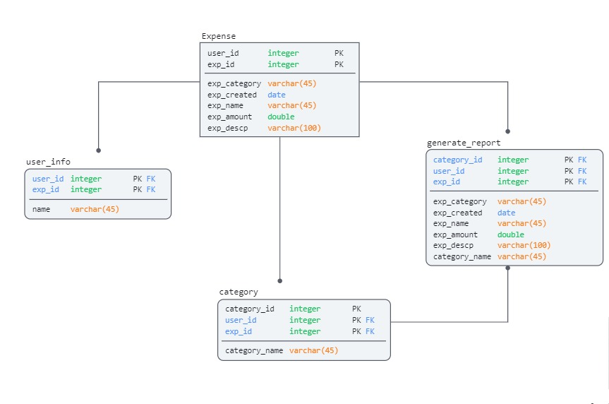

Slide 10
Technologies :
Programming language : Java
Database : Mysql
JDBC ( for connecting to Database )
User Interface : Java Swing
Tools :
NetBeans
Eclipse IDE
Visual Studio Code Editor

Slide 11
THANK YOU !!!

